Slide 1
Chapter 8: Relational Database Design- Functional Dependencies
Notes:
1

Slide 2
Canonical Cover
Sets of functional dependencies may have redundant dependencies that can be inferred from the others
For example: A → C is redundant in: {A → B, B → C, A-> C}
Parts of a functional dependency may be redundant
E.g.: on RHS: {A → B, B → C, A → CD} can be simplified to {A → B, B → C, A → D}
E.g.: on LHS: {A → B, B → C, AC → D} can be simplified to {A → B, B → C, A → D}
Intuitively, a canonical cover of F is a “minimal” set of functional dependencies equivalent to F, having no redundant dependencies or redundant parts of dependencies
Notes:
2

Slide 3
Extraneous Attributes
Consider a set F of functional dependencies and the functional dependency α → β in F.
Attribute A is extraneous in α if A ∈ α and F logically implies (F – {α → β}) ∪ {(α – A) → β}.
Attribute A is extraneous in β if A ∈ β and the set of functional dependencies (F – {α → β}) ∪ {α →(β – A)} logically implies F.
Note: implication in the opposite direction is trivial in each of the cases above, since a “stronger” functional dependency always implies a weaker one
Example: Given F = {A → C, AB → C }
B is extraneous in AB → C because {A → C, AB → C} logically implies A → C (I.e. the result of dropping B from AB → C).
Example: Given F = {A → C, AB → CD}
C is extraneous in AB → CD since AB → C can be inferred even after deleting C
Notes:
3

Slide 4
Testing if an Attribute is Extraneous
Consider a set F of functional dependencies and the functional dependency α → β in F.
To test if attribute A ∈ α is extraneous in α
compute ({α} – A)⁺ using the dependencies in F
check that ({α} – A)⁺ contains β; if it does, A is extraneous in α
To test if attribute A ∈ β is extraneous in β
compute α⁺ using only the dependencies in F’ = (F – {α → β}) ∪ {α →(β – A)},
check that α⁺ contains A; if it does, A is extraneous in β
Notes:
4

Slide 5
Canonical Cover
A canonical cover for F is a set of dependencies F_{c} such that
F logically implies all dependencies in F_{c,} and
F_{c} logically implies all dependencies in F, and
No functional dependency in F_{c} contains an extraneous attribute, and
Each left side of functional dependency in F_{c} is unique.
To compute a canonical cover for F: repeat Use the union rule to replace any dependencies in F α₁ → β₁ and α₁ → β₂ with α₁ → β₁ β₂ Find a functional dependency α → β with an extraneous attribute either in α or in β /* Note: test for extraneous attributes done using F_{c,} not F*/ If an extraneous attribute is found, delete it from α → β until F does not change
Note: Union rule may become applicable after some extraneous attributes have been deleted, so it has to be re-applied
Notes:
5

Slide 6
Computing a Canonical Cover
R = (A, B, C) F = {A → BC B → C A → B AB → C}
Combine A → BC and A → B into A → BC
Set is now {A → BC, B → C, AB → C}
A is extraneous in AB → C
Check if the result of deleting A from AB → C is implied by the other dependencies
Yes: in fact, B → C is already present!
Set is now {A → BC, B → C}
C is extraneous in A → BC
Check if A → C is logically implied by A → B and the other dependencies
Yes: using transitivity on A → B and B → C.
Can use attribute closure of A in more complex cases
The canonical cover is: A → B B → C
Notes:
6

Slide 7
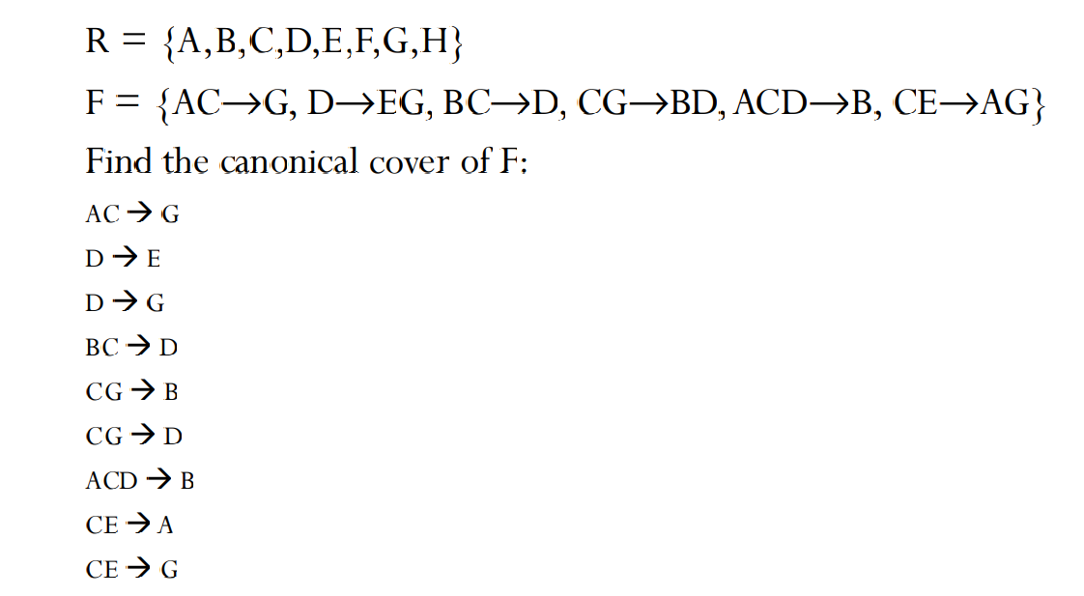
Computing a Canonical Cover

Slide 8
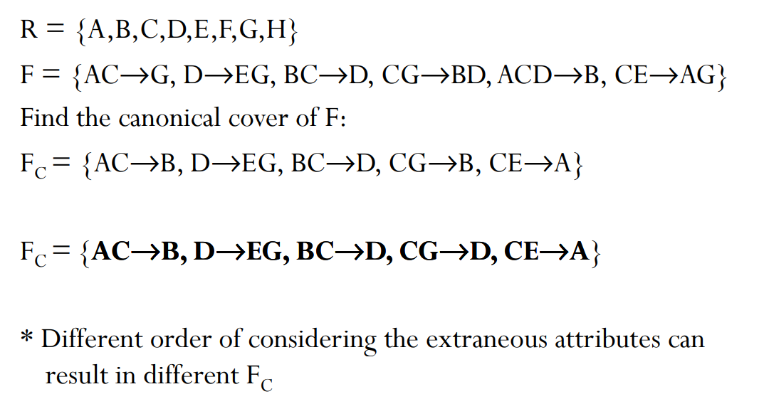
Computing a Canonical Cover

